Slide 1
Self-assigned ranking of L2 vocabulary:
Using the Bricklayer computer game to assess
depth of word knowledge
Heidi Brumbaugh 2015

Slide 2
Main idea and possible applications
Bricklayer allows learners to self-assess large numbers of words in a game rather than test format
Instruction
Large-scale student assessments for academic programs (such as university entrance exams),
Research into vocabulary acquisition

Slide 3
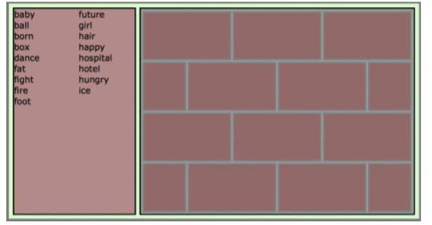
Workflow

Slide 4
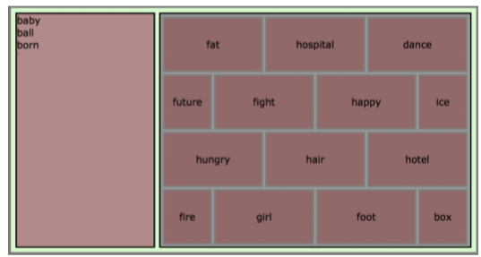
Workflow

Slide 5
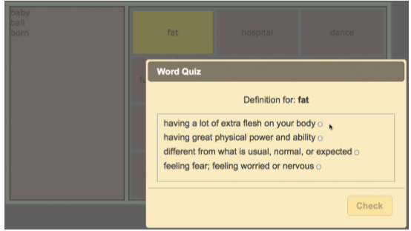
Workflow

Slide 6
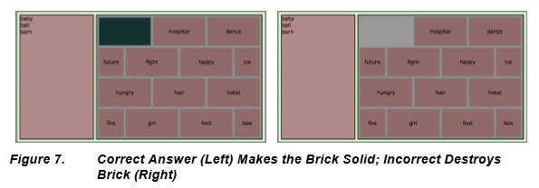
Game result

Slide 7
Win strategy
The strategy for success in the game is for players to put the words they think they know the best at the bottom, with words they know pretty well in the middle, and words they are not completely sure about near the top.

Slide 8
Main concerns
Does the strength of this prediction provide a measurement for the learner’s depth of knowledge for that word? If so, what type(s) of depth of knowledge is (are) being represented?
Does the learner’s target score for a word accurately predict the learner’s knowledge for that word?
Does the assessment tool work equally well for all lexical items? If not, what lexical and/or psycholinguistic features predict a word’s fitness for this type of assessment tool?
Does Bricklayer provide more accurate vocabulary assessment than a checkbox system with regards to prediction of word knowledge?

Slide 9
Model domains
Target domain A model of lexical knowledge for a particular student for a particular list of words (a lexical set).
Observation The examinee engaged in an assessment (a gameplay) in which they positioned some words (out of the lexical set) onto a board (the gameboard
Observed Scores
gamescore (overall points of the game)
wordscore (percentage of the board that is supported by the brick on which the word was dropped)
quizscore (binary)

Slide 10
Model domains
Contributing Scores Scores contribute evidence which accumulates to build a probability model of the learner’s lexical knowledge
Construct The contributing scores for each lexical item are attributed to a construct of the examinee’s lexical knowledge for that item (structural validity).
Target Score For each lexical item, the target score indicates the probability that the word is known or unknown by the individual learner.
Test Use The measurement for each word can be used to show what kind of attention needs to be paid to the word in order to boost knowledge for that word.

